Slide 1
SWOT PowerPoint PPT Template
Strength
Opportunities
This slide is 100% editable. Adjust it as per your requirements and catches your viewers consideration.
This slide is 100% editable. Adjust it as per your requirements and catches your viewers consideration.
Weakness
Threats
This slide is 100% editable. Adjust it as per your requirements and catches your viewers consideration.
This slide is 100% editable. Adjust it as per your requirements and catches your viewers consideration.

Slide 2
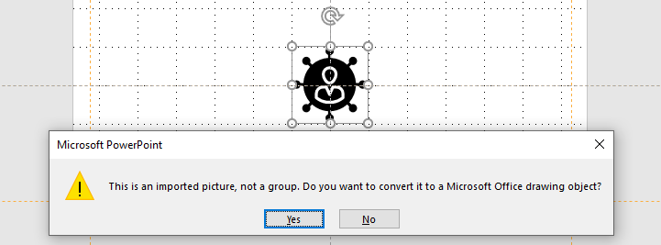
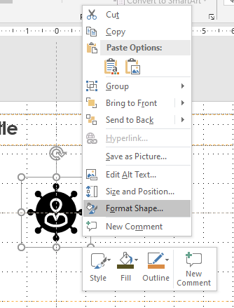
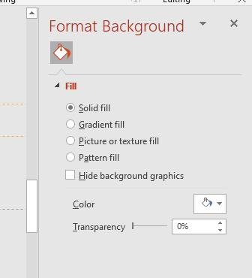
Guidelines
Edit Icon
You can change the color and size of the icon. Select the “icon” and ungroup it using “shift + ctrl + G” Click on “Yes”.
You change the color and orientation of the icon by right click the icon and click on “format shape”.
After making the change, select the entire icon and group it using “Ctrl +G”.

Slide 3
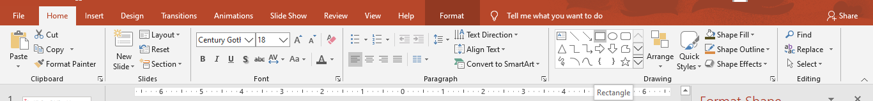
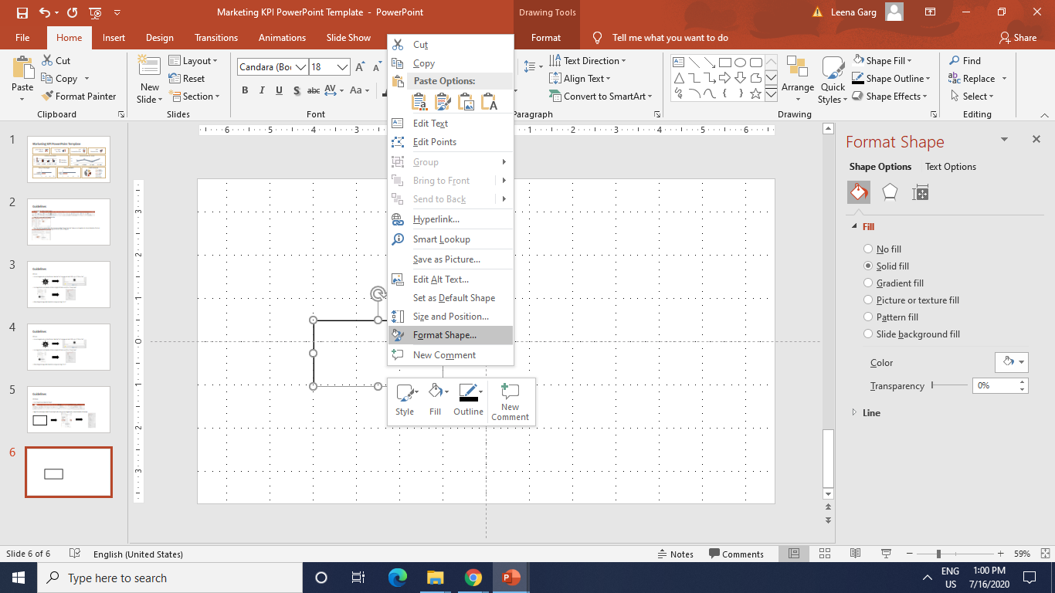
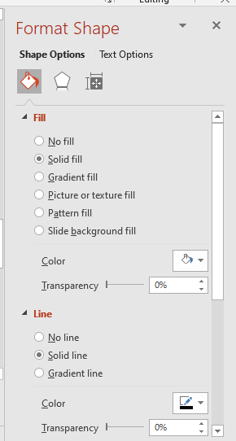
Guidelines
Edit Shape
Go to “Home” tab and select the “Shape”.
Right click on the shape and select “Format shape” option. Now, you can change the color, size and orientation of the shape..

